Slide 1
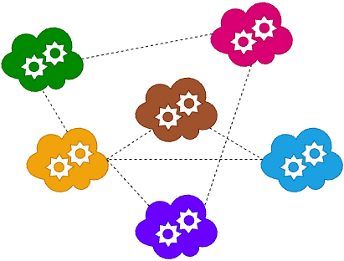
BINV3140-D Microservices
Lesson 3
2025-2026
Choquet Olivier
Miri Tarik
Strebelle Sébastien

Slide 2

Table of Content
Lesson’s Objective
Summary Lesson 1 & 2
The Communication Challenge
Two Types of Communication
Synchronous Communication
Asynchronous Communication
Typical Challenges
Synchronous vs Asynchronous
Summary

Slide 3
1. Lesson’s Objectives
1
Understand why communication is central to microservices.
2
Distinguish between synchronous and asynchronous communication.
3
Learn strengths and weaknesses of both approaches.
4
Understand typical communication challenges
5
Determine when to use synchronous vs asynchronous communication

Slide 4
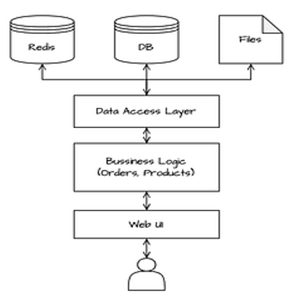
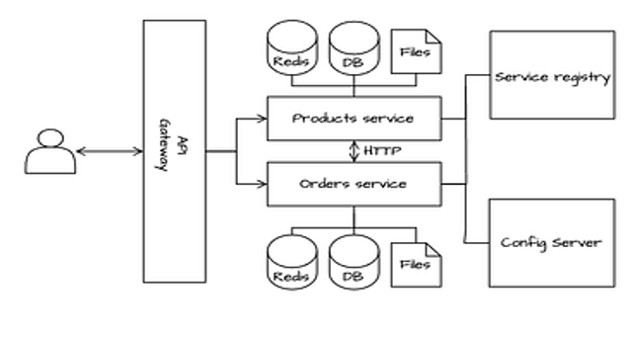

2. Summary Lesson 1 & 2
Monolith Architecture
Microservices Architecture
Key Takeaways
1
Microservices are small, independent services, each built around a business capability with its own data. They can be developed and deployed separately, but must collaborate to deliver value.
2
Boundaries are set by business capabilities, ensuring each microservice focuses on a clear domain like orders, payments, or customers.
3
Each microservice owns and manages its own database. This ensures loose coupling, clearer responsibility, and allows services to evolve or scale independently without conflicts.
Challenge
While each service is autonomous, real business value comes from their collaboration. This creates challenges in communication, data consistency, and reliability across a distributed system.

Slide 5
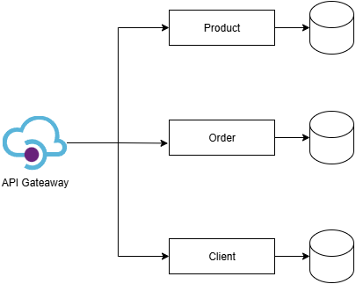

3. The Communication Challenge
Why communication is hard
Monolith Architecture
1
Microservices are independent → cannot share memory directly. Each microservice runs in its own process and manages its own data, which means they cannot exchange information through shared memory like components inside a monolith.
Responsible for managing products and stock in an inventory
2
Check stock
They must communicate over a network. To work together, services rely on network protocols such as HTTP, gRPC, or messaging systems, introducing latency and potential failures.
Responsible for managing clients’ information
3
Enable collaboration without tight coupling. The goal is to let services depend on each other’s outputs while remaining loosely coupled, so that one service can evolve or fail without breaking the whole system.
Retrieve orders history
Validate client’s information
Responsible for managing clients’ orders
4
Trade-offs: simplicity vs resilience, speed vs decoupling. Designing communication means balancing ease of implementation and performance against robustness, fault tolerance, and long-term flexibility.
Independent services only deliver business value when they communicate reliably — but that communication adds complexity, trade-offs, and potential points of failure.

Slide 6



4. Two Types of Communication
Synchronous Communication
Asnchronous Communication
In a synchronous model, the client calls a service and waits for its reply before moving on. This request/response style is easy to understand and implement, but it ties the availability and performance of the client to the service it depends on.
In an asynchronous model, a producer sends a message or event to a broker, which then distributes it to interested consumers. The producer does not wait for a reply, which allows services to be more resilient and scalable, but also introduces delays and eventual consistency.
Microservices must communicate to work together. Sometimes a direct request/response is needed for immediate results, while in other cases events and messages allow systems to stay decoupled and resilient. In practice, both models are combined to achieve flexibility and reliability.

Slide 7
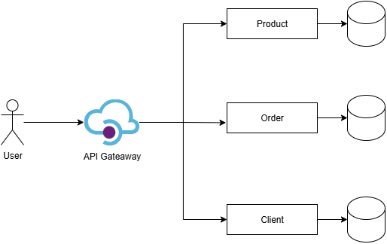
5. Synchronous Communication
example
When a customer places an order, the Order Service synchronously checks product stock and validates client information with the respective services before confirming and saving the order.
Description
Pros
1
User (Client) sends a request through the application interface to place a new order.
Simple & familiar (HTTP/REST, gRPC).
Immediate result for the caller (easy UX).
Easier debugging with clear request/response trace.
Good fit for reads and operations needing instant confirmation.
2
API Gateway forwards the request to the Order Service. The user receives a response.
3
3
Order Service checks product stock by making a synchronous request to the Product Service and waits for the response.
1
2
6
5
4
Cons
Order Service validates customer details by synchronously calling the Client Service to confirm the customer exists and is valid.
4
Tight runtime coupling — caller depends on callee’s availability.
Cascading failures and latency amplify across call chains.
Scalability limits (hard to absorb spikes; caller blocks).
Chatty networks increase overhead and cost.
Retry/timeout complexity to stay reliable.
5
Order Service returns the confirmation response to the API Gateway,
6
API Gateway returns the confirmation to the user, completing the request/response cycle.

Slide 8
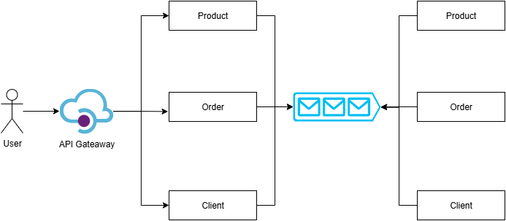
6. Asynchronous Communication
example
When a customer places an order, the Order Service asynchronously checks product stock and validates client information with the respective services before confirming and saving the order.
Description
Pros
1
User (Client) sends a request through the application interface to place a new order.
Loose coupling → services don’t block each other.
Scalable & resilient → consumers scale, retries possible.
Flexible → easy to add new consumers.
Smooths load with message buffering.
2
Order Service publishes an OrderCreated event to the message broker instead of calling other services directly.
1
2
4
6
3
API Gateway forwards the request to the Order Service. The user receives a response.
4
Cons
3
Product Service consumes the event to check and reserve stock, then publishes a StockReserved or StockRejected event.
5
Eventual consistency → data not always up to date.
More complex → broker + event management.
Harder to debug distributed flows.
Delivery issues → need idempotency/deduplication.
Slower user feedback → usually requires a Notification Service.
5
Client Service consumes the event to validate customer details and may publish a CustomerValidated or Rejected event.
6
Order Service listens for these events from Product and Client, updates the order state, and continues the workflow.

Slide 9
7. Typical Challenges (1/2)
Challenge
Description
Solution
Service Unavailability
When one service depends on another, an outage in the callee can block the caller. This can create a chain reaction where one failure brings down multiple parts of the system.
Add timeouts and retries so the caller doesn’t wait forever. Use a circuit breaker pattern to temporarily stop calling failing services until they recover.
High Latency
A single user request may pass through many services. Each extra hop adds waiting time, so the total response can become very slow if one service is delayed.
Reduce the number of hops where possible, use caching for common data, and let the API Gateway aggregate calls to reduce round trips.
Traffic Spikes
A sudden burst of requests can overwhelm a service and cause it to crash or reject users.
Use asynchronous queues to absorb peaks. Enable auto-scaling and apply rate limiting to protect services under high load.
Messages Duplication
When services communicate through events, a message may be delivered more than once. Without precautions, this can lead to duplicate actions such as double-charging a customer.
Design services to be idempotent (safe to process the same message twice). Add deduplication logic or unique request IDs.
Debugging Difficulty
In a distributed system, a single request can touch many services. If something fails, it is hard to trace the cause without visibility across services.
Use logging with correlation IDs and distributed tracing tools to follow requests from start to finish. This makes it easier to locate issues.
Finding Services
In microservices, services move, scale, or restart dynamically. Their IPs and ports can change, so hardcoding addresses doesn’t work.
Use a service registry (e.g., Consul, Eureka) or service mesh. An API Gateway can act as a single entry point for clients.

Slide 10
7. Typical Challenges (2/2)
Challenge
Description
Solution
API & Contract Drift
If a service changes its API or event format, consumers may break unexpectedly. This makes systems fragile and hard to evolve.
Keep backward compatibility, version APIs and events, and use schema validation (OpenAPI, gRPC, or Schema Registry) to prevent breaking changes.
Security Between Services
In a microservices system, every service-to-service call is a potential attack path. Without proper authentication and encryption, malicious access is possible.
Use mTLS for service-to-service calls, enforce authentication with tokens (e.g., JWT), and apply least privilege on APIs.
Chatty Communication
If services exchange many small requests, network overhead grows and response times degrade. This is especially problematic when services call each other in loops.
Batch requests where possible, use pagination, or introduce GraphQL/aggregated endpoints to reduce network calls.
Communication is at the heart of microservices. Each challenge has proven solutions, but all designs must balance simplicity, performance, and resilience.

Slide 11


8. Synchronous vs Asynchronous
Synchronous and asynchronous communication each have strengths; the best choice depends on the situation.
Scenario
Synchronous
Asynchronous
Justification
Checking stocks before confirming an order
The user must know immediately if the product is available to complete checkout. Async would delay feedback and frustrate the user.
Send a confirmation email after the order is created
Email is not required immediately; it can be triggered by an OrderConfirmed event. Async ensures the checkout flow is fast for the user.
Managing Black Friday traffic spikes
Synchronous requests would overload services under peak demand. With async queues, requests are buffered and processed as capacity allows.
The system validates a customer account during order creation
Validation must happen instantly to prevent invalid orders from entering the system. Async would allow orders from non-existent or blocked accounts.
Generating a monthly sales report
Reports don’t need to block the user experience. Events from orders can be collected asynchronously and processed later for analytics.

Slide 12




9. Summary
Microservices are independent but must collaborate to deliver value.
Two main communication styles: synchronous (immediate response) and asynchronous (event-driven, decoupled).
Each style has strengths, weaknesses, and use cases.
The key is choosing the right tool for the right situation.

Slide 13
Exercise
Lesson 3
2025-2026
Choquet Olivier
Miri Tarik
Strebelle Sébastien

Slide 14


1. Lesson 3 Exercise
An example of solution to address last week’s exercise is proposed to start from good foundations to complete this week’s exercise
GitHub repository URL: https://github.com/Aktorius/microservices-lesson2-spring
Detailed steps to set-up your environment and run the solution are covered in the README.md file
Objectives of the Exercise
Install a message broker on your local machine (Rabbit MQ)
Replace inter-service communication with asynchronous messaging, but keep the synchronous approach for the API gateway
Emit and consume events, suggestion to get you inspired
OrderCreated published from the Order service
StockReserved/StockRejected published from the Product service
Think about the sequence of execution when placing an order, list the steps including events published and consumed.

Slide 15
2. Install and Configure RabbitMQ
Download and install Erland: https://www.erlang.org/downloads
Download and install RabbitMQ: https://www.rabbitmq.com/docs/download
Once installed, make sure to run the RabbitMQ Service. Verify that the service is running in the task manager
Add sbin folder of RabbitMQ to your PATH
Run rabbitmq-plugins enable rabbitmq_management to enable the admin UI, then restart RabbitMQ service in task manager
Add dependency to the pom.xml files of the projects that will interact with RabbitMQ
<dependency>
<groupId>org.springframework.boot</groupId>
<artifactId>spring-boot-starter-amqp</artifactId>
</dependency>
Create the RabbitMQ configuration class in a new package messaging (in each service to simplify the exercise)
Add the relevant event classes in messaging.events in the services that need them
Add rabbitmq configuration to the application.yml of each service
spring:
rabbitmq:
host: localhost
port: 5672
username: guest
password: guest
Create event listener classes
Modify the code of the service classes to publish events

